Slide 1
Android studio
Game development

Slide 2
Creating a new project

Slide 3
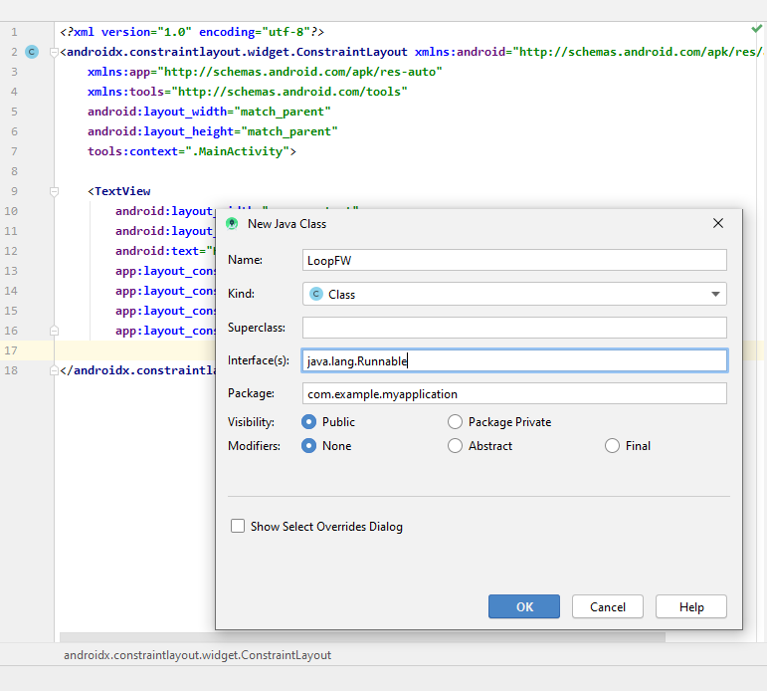
Adding a new module
We need to add a new module – Android library. After it, we add a new class.

Slide 4
Add start / stop methods
In LoopFW we need to add several methods.
package com.example.myapplication; import java.util.Date;
public class LoopFW implements Runnable { private final float FPS = 60; private final float SECOND = 1000000000; private final float UPDATE_TIME = SECOND / FPS; private boolean running = false; Thread gameThread = null; float updates = 0; float drawing = 0; long timer = 0; @Override public void run() { } public void startGame(){ if (running){ return; } running = true; gameThread = new Thread(this); gameThread.start(); } public void stopGame() { if(!running){ return; } running = false; try { gameThread.join(); } catch (InterruptedException e) { e.printStackTrace(); } } }

Slide 5
Adding additional methods
@Override public void run() { float lastTime = System.nanoTime(); float delta = 0; timer = System.currentTimeMillis(); while(running){ float nowTime = System.nanoTime(); float elapsedTime = nowTime - lastTime; lastTime = nowTime; delta += elapsedTime / UPDATE_TIME; if (delta > 1){ updateGame(); drawingGame(); delta--; } if(System.currentTimeMillis() - timer > 1000){ Date date = new Date(); System.out.print("UPDATES = "+ updates + "DRAWING " + drawing + " "+ date.toString()); updates = 0; drawing = 0; timer += 1000; } } } private void updateGame() { updates ++; } private void drawingGame(){ drawing ++; }

Slide 6
Launching the method
We need to launch the method from the main class
package com.example.myapplication; import androidx.appcompat.app.AppCompatActivity; import android.os.Bundle; public class MainActivity extends AppCompatActivity { @Override protected void onCreate(Bundle savedInstanceState) { super.onCreate(savedInstanceState); setContentView(R.layout.activity_main); LoopFW loop = new LoopFW(); loop.startGame(); } }

Slide 7
Run the application

Slide 8
Creating core class

